Slide 1
Web Scraping
Dusty Turner
22 March 2018

Slide 2
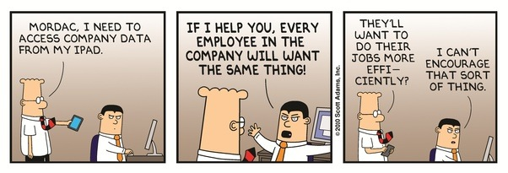
We All Have This Problem
I NEED DATA
NOW
ALL OF IT

Slide 3
Road Map
Difficulty
Solution
Reward
Easy*
Excel
Copy/Paste
Low
Moderate
Google Sheets
Low
Hard**
R
Through the Roof
* Not really all that easy
** Not really all that hard

Slide 4
Road Map
Difficulty
Solution
Reward
Lots of Work
Easy*
Excel
Copy/Paste
Low
Moderate
Google Sheets
Low
Hard**
R
Through the Roof

Slide 5
Ethics
Two Main Issues:
Purpose: Its not your data.
Execution: Too much traffic slows down the website.

Slide 6
Ethics
Addressing these issues with good practices
Purpose
Never pass off other’s data as your own.
Send recipients of your analysis back to the source.
Scrape only with the intent of creating new value from the data.
Execution
If an API (Application Programming Interface) is available, use it.
Request data at a reasonable rate.
Save only the data you need.
https://towardsdatascience.com/ethics-in-web-scraping-b96b18136f01

Slide 7
Lets Begin: Easy*
Excel
http://www.espn.com/mens-college-basketball/bpi

Slide 8
Next: Moderate
Google Sheets
https://docs.google.com/spreadsheets/d/1oV5zHEzQolQta8VfwH1f1KOrW_vwpr0tK2JLrSf2BtQ/edit#gid=0

Slide 9



Next: R**
Need:
R / R Studio
‘Rvest’ Package
URLs of interest
Cascading Style Sheets (CCS) Selector
http://selectorgadget.com/
Hadley Wickham
hadley
@hadleywickham

Slide 10

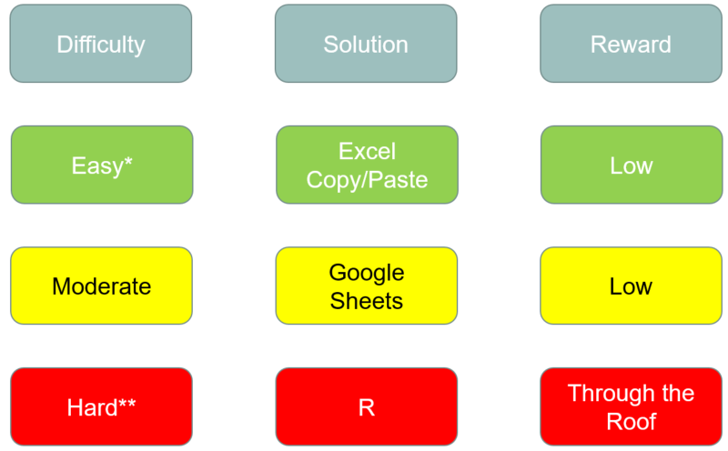
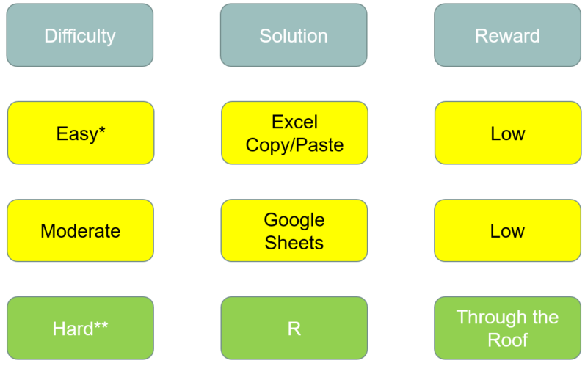




In Conclusion

